Slide 1


1
2
3
4
ENERGY CONSUMPTION ACROSS BORDERS
GitHub
Queries
Git
Tables
Explore Git’s core features like version control, branching, and merging, and see how we used it to enhance collaboration.
Describe GitHub’s role in our project and its use for teamwork.
Discover how we structured and connected our tables to analyze energy trends and global data relationships.
Present SQL queries for data analysis. Explain their goals and highlight key results

Slide 2
1
2
3
4
GitHub
Git
Tables
Queries
Describe GitHub’s role in our project and its use for teamwork.
Explore Git’s core features like version control, branching, and merging, and see how we used it to enhance collaboration.
Discover how we structured and connected our tables to analyze energy trends and global data relationships.
Present SQL queries for data analysis. Explain their goals and highlight key results

Slide 3
1
GitHub
Describe GitHub’s role in our project and its use for teamwork.

Slide 4
What is GitHub?
Web-based platform:
Version control
Collaboration
GitHub combines these two features to enhance teamwork and code management.

Slide 5
Why GitHub was essential
Efficient collaboration
Traceability
Transparency
These features are powered by Git, the version control system.

Slide 6
2
Git
Explore Git’s core features like version control, branching, and merging, and see how we used it to enhance collaboration.

Slide 7

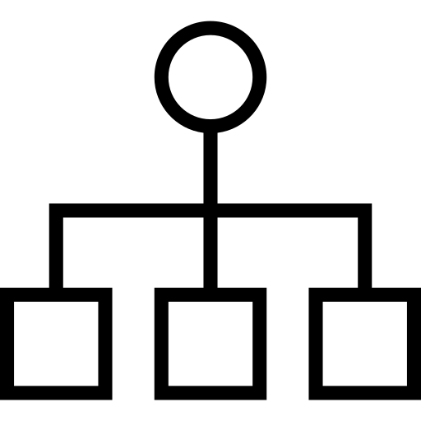
What is Git?
Functions:
Tracks changes in files
Allows you to load previous versions
Supports branching and merging

Slide 8
How did we use Git?
Clone Repository
Creating Branches
Commit and Push changes
Pull Requests and Merge

Slide 9
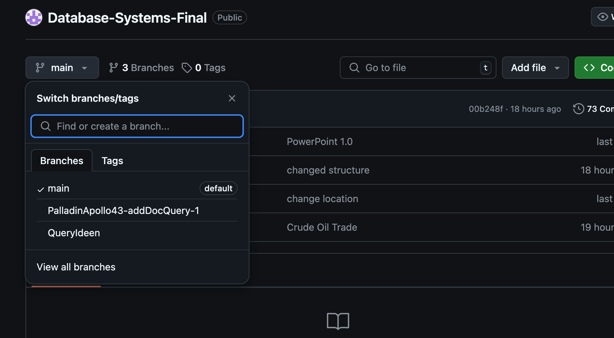
Example for Branches

Slide 10
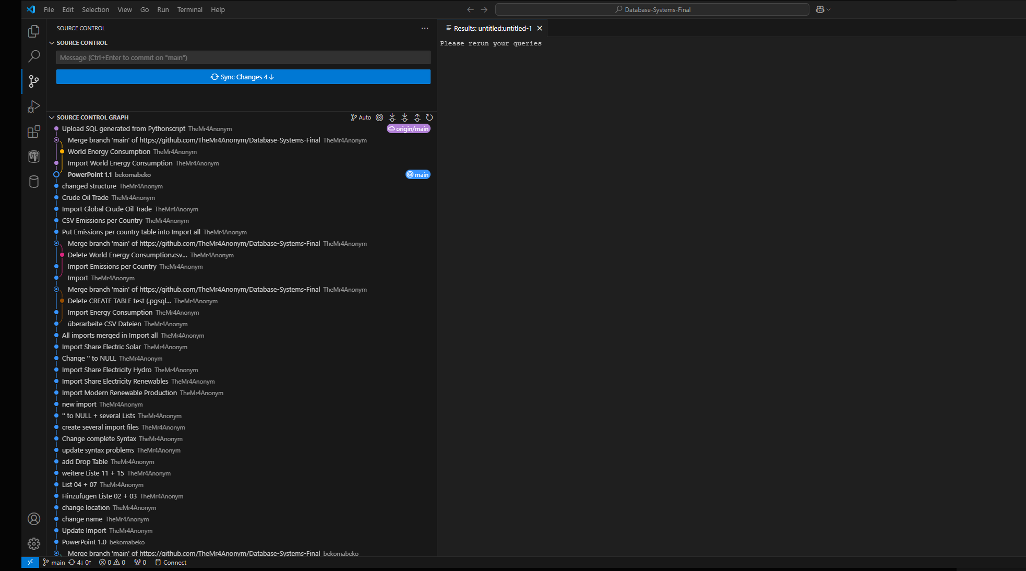
Example for Commits

Slide 11
3
Tables
Discover how we structured and connected our tables to analyze energy trends and global data relationships.

Slide 12




HOW CAN WE IDENTIFY THE GLOBAL TRENDS IN RENEWABLE ENERGY?

Slide 13
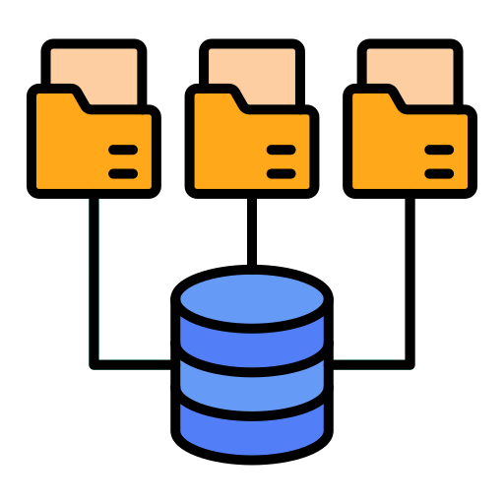

WE NEED A SOURCE/DATASET
They need to be:
robust
diverse
useful
kaggle.com

Slide 14



HOW CAN TABLES HELP US ABOUT ENERGY CONSUMPTION?

Slide 15
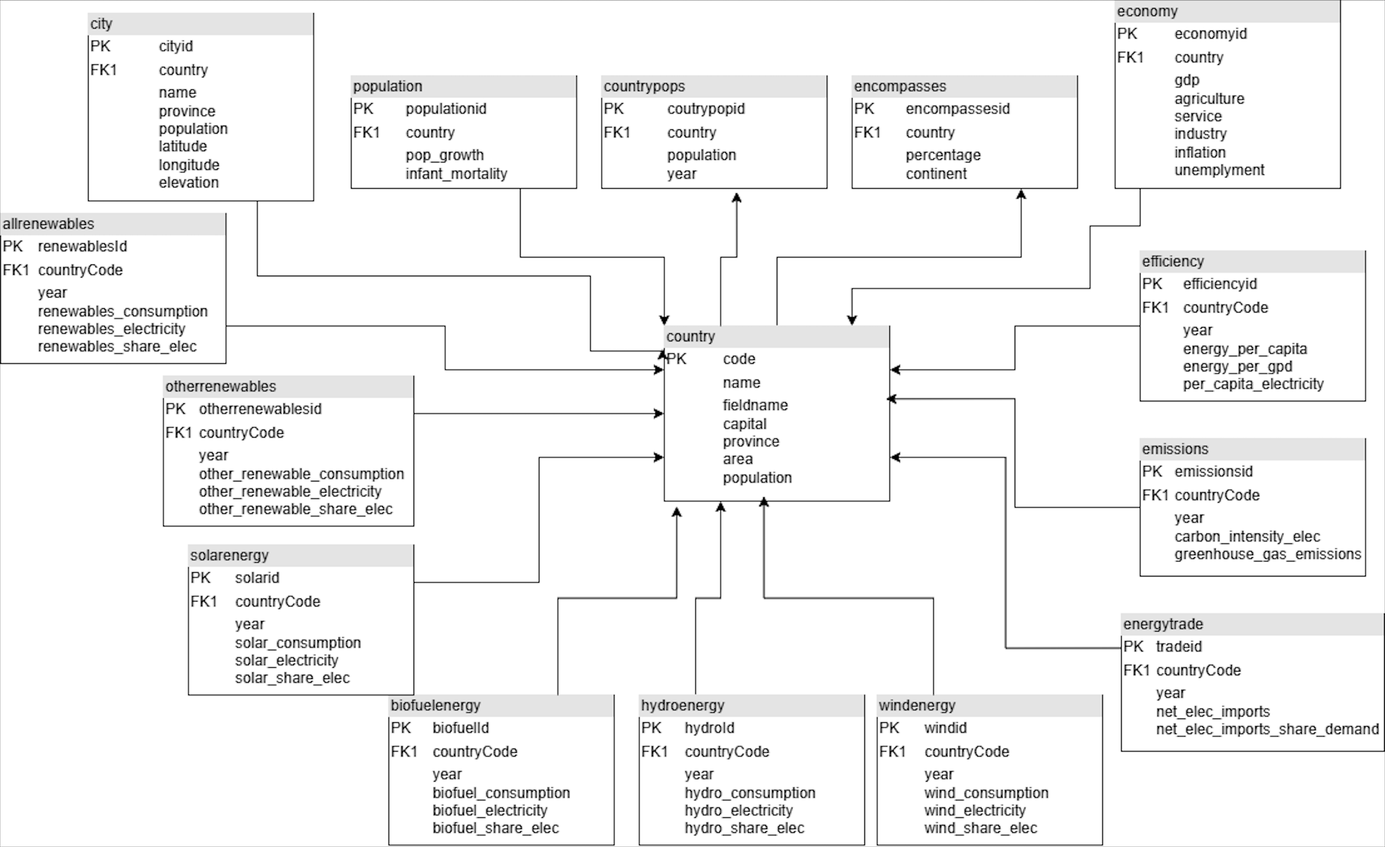
mondial
main table
renewables
energy types
environment

Slide 16
4
Queries
Present SQL queries for data analysis. Explain their goals and highlight key results

Slide 17
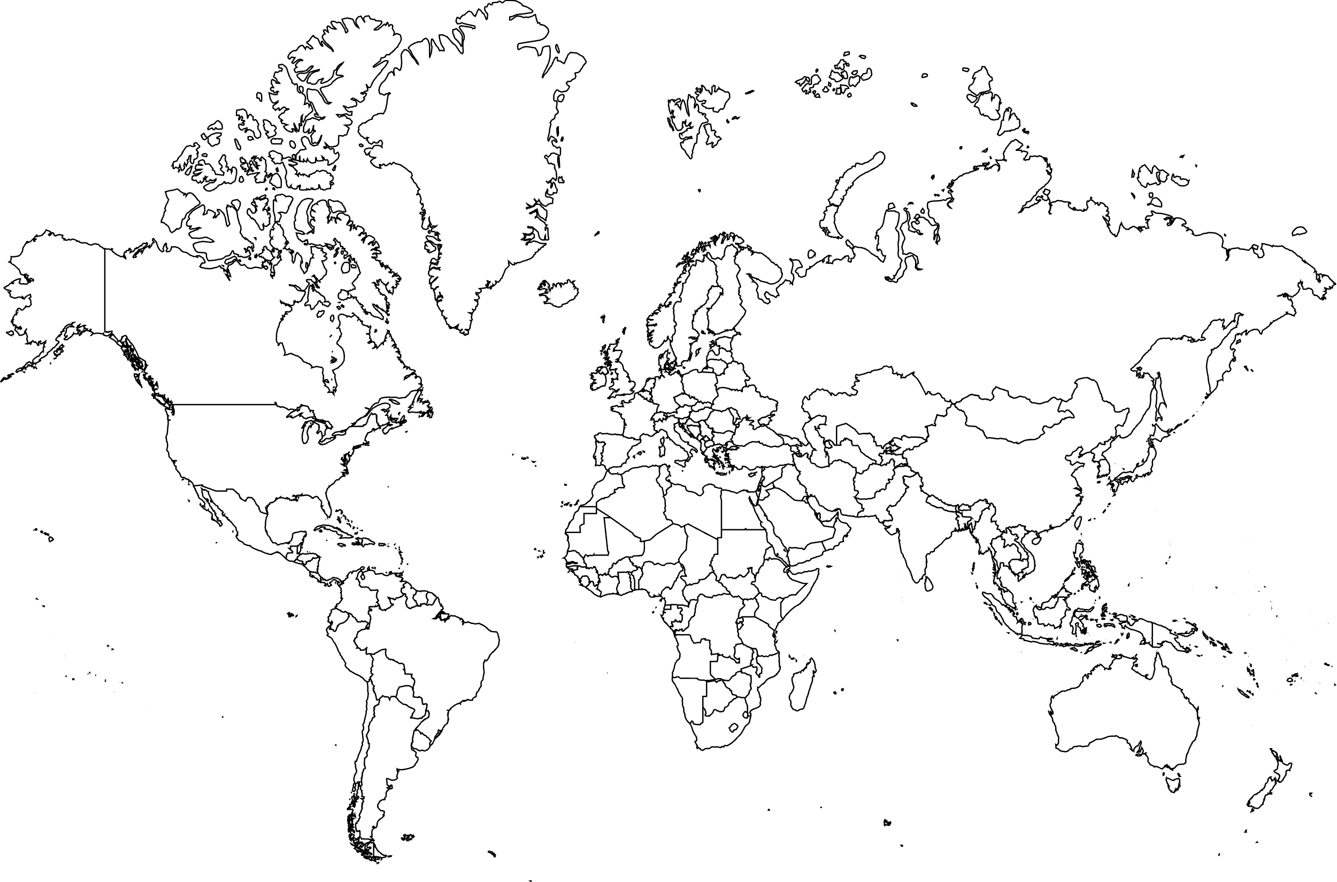

Slide 19

Thank You!

